Slide 1
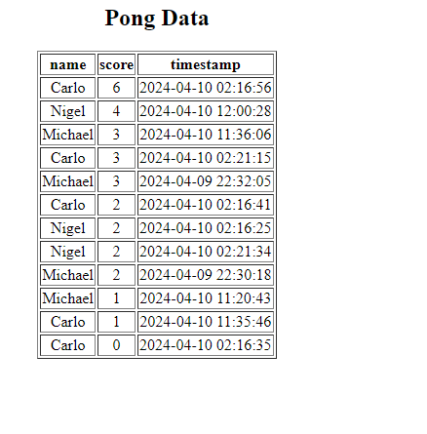
The dataset housed within the database that is meticulously rendered onto the web interface.

Slide 2
The first visual highlights the crontab setup, automating task scheduling for system efficiency. Following, the second image showcases the script executed by crontab every minute, designed to upload data into the database, reflecting our focus on real-time data accuracy and responsiveness.

Slide 3
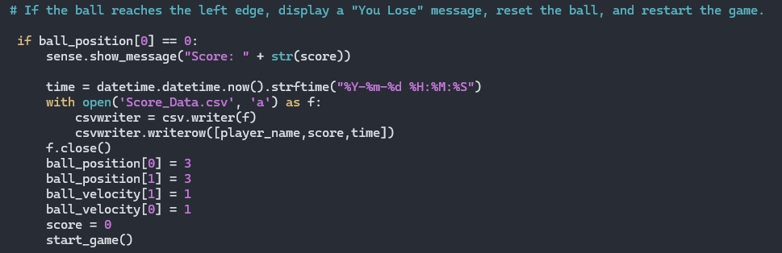
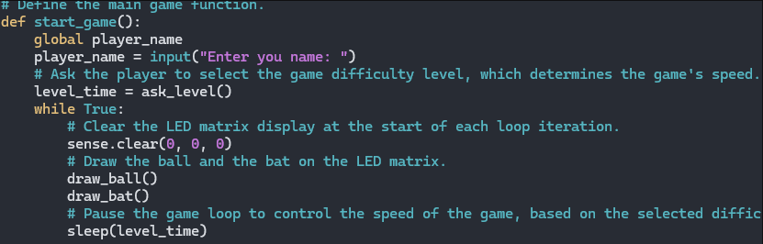
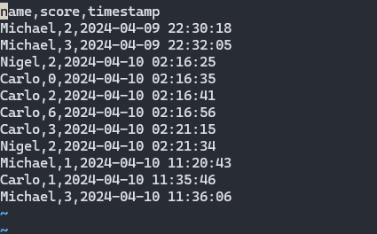
Documents tailored to facilitate the realization of Milestone 4.

Slide 4
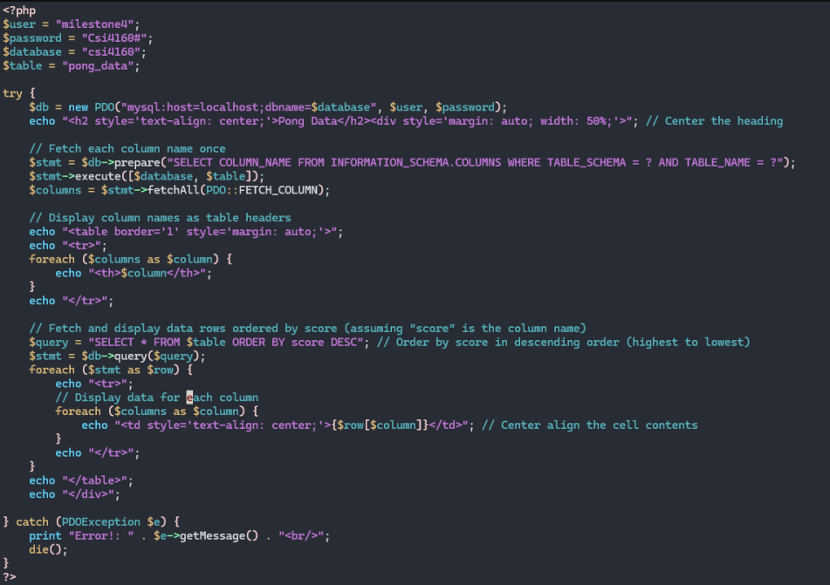
The PHP file executes a query to the MySQL database, rendering its data dynamically on a webpage, showcasing our integration of backend data with frontend display.

